Slide 1
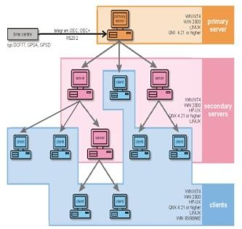
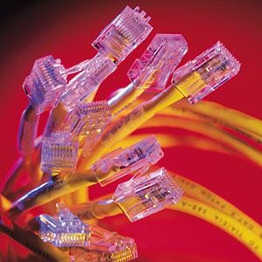


Introduction to Networks and Networking Concepts
NETWORKING

Slide 2



What is Networking?
involves connecting computers and other electronic devices
sharing information and resources
communication
Notes:
Networking involves connecting computers and other electronic devices for the purpose of sharing information and resources and for communication
A great deal of technology is required for one device to connect and communicate with another, and many choices for physical connections and related software are possible

Slide 3
Networking Fundamentals
elementary network - two computers connected by some kind of transmission medium
Sharing enables users to exchange information and route data between them as workflow demands
Peripheral device sharing enables users to take advantage of peripherals and other devices attached directly to a network or to a generally available computer attached to a network
Notes:
An elementary network consists of two computers connected by some kind of transmission medium
Motivation: need to share data and to communicate quickly and efficiently
Sharing enables users to exchange information and route data between them as workflow demands
Can improve human communication substantially
Peripheral device sharing enables users to take advantage of peripherals and other devices attached directly to a network or to a generally available computer attached to a network (printers, scanners for example)

Slide 4
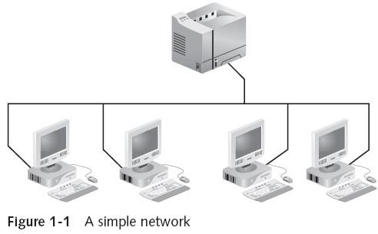
Networking Fundamentals

Slide 5
Kinds of Network
Personal Area Network (PAN)
The smallest and most basic type of network, a PAN is made up of a wireless modem, a computer or two, phones, printers, tablets, etc., and revolves around one person in one building. These types of networks are typically found in small offices or residences, and are managed by one person or organization from a single device.
Notes:
Local Area Network (LAN): small network,
limited to a single collection of machines and one
or more cables and other peripheral equipment
Internetwork: networked collection of LANs tied together by devices such as routers
– The Internet is the best example
Wide Area Network (WAN): internetwork that spans distances measured in miles and links two or more separate LANs
Metropolitan Area Network (MAN): uses WAN technologies to interconnect LANs in a specific geographic region, such as a county or a city

Slide 6
Kinds of Network
Personal Area Network (PAN)
There are two types of PAN:
Wired Personal Area Network
Wireless Personal Area Network
Notes:
Local Area Network (LAN): small network,
limited to a single collection of machines and one
or more cables and other peripheral equipment
Internetwork: networked collection of LANs tied together by devices such as routers
– The Internet is the best example
Wide Area Network (WAN): internetwork that spans distances measured in miles and links two or more separate LANs
Metropolitan Area Network (MAN): uses WAN technologies to interconnect LANs in a specific geographic region, such as a county or a city

Slide 7
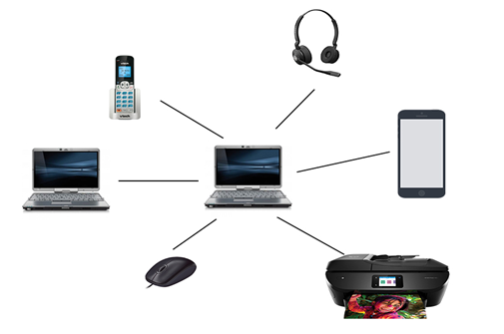
Kinds of Network
https://static.javatpoint.com/tutorial/computer-network/images/personal-area-network.png
Notes:
Local Area Network (LAN): small network,
limited to a single collection of machines and one
or more cables and other peripheral equipment
Internetwork: networked collection of LANs tied together by devices such as routers
– The Internet is the best example
Wide Area Network (WAN): internetwork that spans distances measured in miles and links two or more separate LANs
Metropolitan Area Network (MAN): uses WAN technologies to interconnect LANs in a specific geographic region, such as a county or a city

Slide 8
Kinds of Network
2. Local Area Network (LAN)
LANs are the most frequently discussed networks, one of the most common, one of the most original and one of the simplest types of networks. LANs connect groups of computers and low-voltage devices together across short distances
Notes:
Local Area Network (LAN): small network,
limited to a single collection of machines and one
or more cables and other peripheral equipment
Internetwork: networked collection of LANs tied together by devices such as routers
– The Internet is the best example
Wide Area Network (WAN): internetwork that spans distances measured in miles and links two or more separate LANs
Metropolitan Area Network (MAN): uses WAN technologies to interconnect LANs in a specific geographic region, such as a county or a city

Slide 9
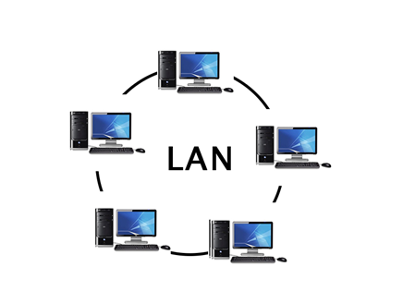
Kinds of Network
https://static.javatpoint.com/tutorial/computer-network/images/local-area-network.png
Notes:
Local Area Network (LAN): small network,
limited to a single collection of machines and one
or more cables and other peripheral equipment
Internetwork: networked collection of LANs tied together by devices such as routers
– The Internet is the best example
Wide Area Network (WAN): internetwork that spans distances measured in miles and links two or more separate LANs
Metropolitan Area Network (MAN): uses WAN technologies to interconnect LANs in a specific geographic region, such as a county or a city

Slide 10
Kinds of Network
3. Wireless Local Area Network (WLAN)
Functioning like a LAN, WLANs make use of wireless network technology, such as Wi-Fi. Typically seen in the same types of applications as LANs, these types of networks don’t require that devices rely on physical cables to connect to the network.
Notes:
Local Area Network (LAN): small network,
limited to a single collection of machines and one
or more cables and other peripheral equipment
Internetwork: networked collection of LANs tied together by devices such as routers
– The Internet is the best example
Wide Area Network (WAN): internetwork that spans distances measured in miles and links two or more separate LANs
Metropolitan Area Network (MAN): uses WAN technologies to interconnect LANs in a specific geographic region, such as a county or a city

Slide 11
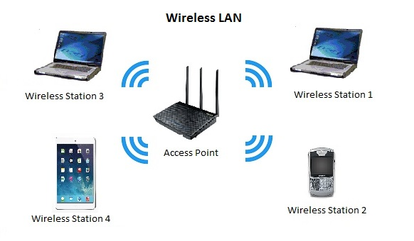
Kinds of Network
https://accoladewireless.com/wp-content/uploads/2015/05/wlan41.jpg
Notes:
Local Area Network (LAN): small network,
limited to a single collection of machines and one
or more cables and other peripheral equipment
Internetwork: networked collection of LANs tied together by devices such as routers
– The Internet is the best example
Wide Area Network (WAN): internetwork that spans distances measured in miles and links two or more separate LANs
Metropolitan Area Network (MAN): uses WAN technologies to interconnect LANs in a specific geographic region, such as a county or a city

Slide 12
Kinds of Network
4. Campus Area Network (CAN)
These types of networks are typically seen in universities, large K-12 school districts or small businesses. They can be spread across several buildings that are fairly close to each other so users can share resources.
Notes:
Local Area Network (LAN): small network,
limited to a single collection of machines and one
or more cables and other peripheral equipment
Internetwork: networked collection of LANs tied together by devices such as routers
– The Internet is the best example
Wide Area Network (WAN): internetwork that spans distances measured in miles and links two or more separate LANs
Metropolitan Area Network (MAN): uses WAN technologies to interconnect LANs in a specific geographic region, such as a county or a city

Slide 13
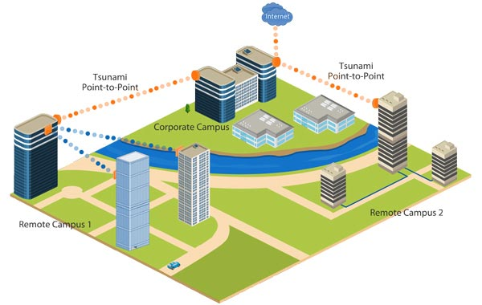
Kinds of Network
https://www.itrelease.com/wp-content/uploads/2019/04/Connection-of-campus-area-network-CAN.jpg
Notes:
Local Area Network (LAN): small network,
limited to a single collection of machines and one
or more cables and other peripheral equipment
Internetwork: networked collection of LANs tied together by devices such as routers
– The Internet is the best example
Wide Area Network (WAN): internetwork that spans distances measured in miles and links two or more separate LANs
Metropolitan Area Network (MAN): uses WAN technologies to interconnect LANs in a specific geographic region, such as a county or a city

Slide 14
Kinds of Network
5. Metropolitan Area Network (MAN)
MANs span an entire geographic area (typically a town or city, but sometimes a campus). Ownership and maintenance is handled by either a single person or company (a local council, a large company, etc.).
Notes:
Local Area Network (LAN): small network,
limited to a single collection of machines and one
or more cables and other peripheral equipment
Internetwork: networked collection of LANs tied together by devices such as routers
– The Internet is the best example
Wide Area Network (WAN): internetwork that spans distances measured in miles and links two or more separate LANs
Metropolitan Area Network (MAN): uses WAN technologies to interconnect LANs in a specific geographic region, such as a county or a city

Slide 15
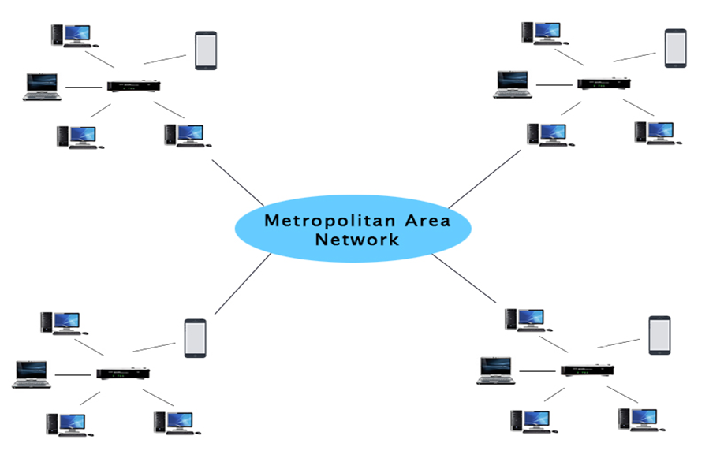
Kinds of Network
https://static.javatpoint.com/tutorial/computer-network/images/metropolitan-area-network.png
Notes:
Local Area Network (LAN): small network,
limited to a single collection of machines and one
or more cables and other peripheral equipment
Internetwork: networked collection of LANs tied together by devices such as routers
– The Internet is the best example
Wide Area Network (WAN): internetwork that spans distances measured in miles and links two or more separate LANs
Metropolitan Area Network (MAN): uses WAN technologies to interconnect LANs in a specific geographic region, such as a county or a city

Slide 16
Kinds of Network
6. Wide Area Network (WAN)
a WAN connects computers together across longer physical distances. This allows computers and low-voltage devices to be remotely connected to each other over one large network to communicate even when they’re miles apart.
Notes:
Local Area Network (LAN): small network,
limited to a single collection of machines and one
or more cables and other peripheral equipment
Internetwork: networked collection of LANs tied together by devices such as routers
– The Internet is the best example
Wide Area Network (WAN): internetwork that spans distances measured in miles and links two or more separate LANs
Metropolitan Area Network (MAN): uses WAN technologies to interconnect LANs in a specific geographic region, such as a county or a city

Slide 17
Kinds of Network
6. Wide Area Network (WAN)
The Internet is the most basic example of a WAN, connecting all computers together around the world. Because of a WAN’s vast reach, it is typically owned and maintained by multiple administrators or the public.
Notes:
Local Area Network (LAN): small network,
limited to a single collection of machines and one
or more cables and other peripheral equipment
Internetwork: networked collection of LANs tied together by devices such as routers
– The Internet is the best example
Wide Area Network (WAN): internetwork that spans distances measured in miles and links two or more separate LANs
Metropolitan Area Network (MAN): uses WAN technologies to interconnect LANs in a specific geographic region, such as a county or a city

Slide 18
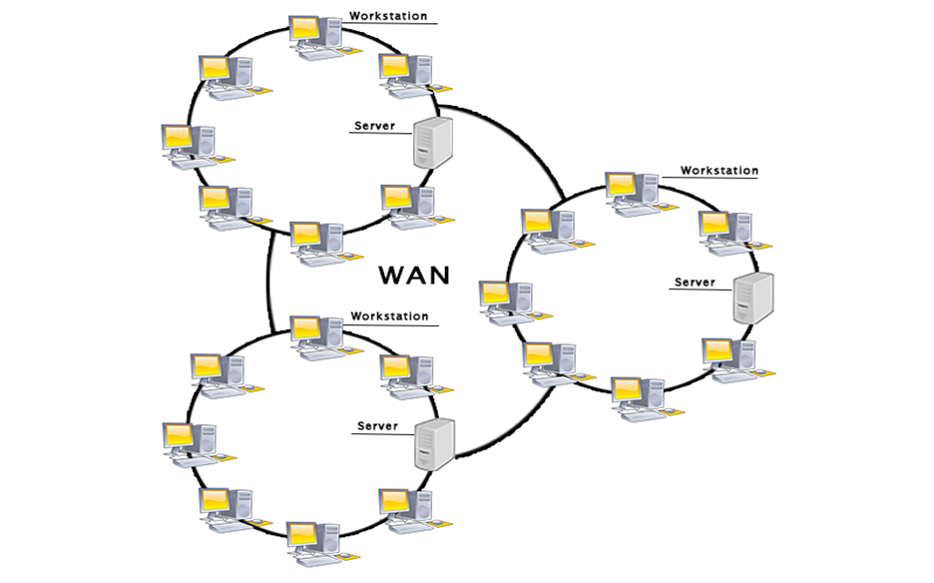
Kinds of Network
https://static.javatpoint.com/tutorial/computer-network/images/wide-area-network.png
Notes:
Local Area Network (LAN): small network,
limited to a single collection of machines and one
or more cables and other peripheral equipment
Internetwork: networked collection of LANs tied together by devices such as routers
– The Internet is the best example
Wide Area Network (WAN): internetwork that spans distances measured in miles and links two or more separate LANs
Metropolitan Area Network (MAN): uses WAN technologies to interconnect LANs in a specific geographic region, such as a county or a city

Slide 19
Kinds of Network
7. Storage-Area Network (SAN)
As a dedicated high-speed network that connects shared pools of storage devices to several servers, these types of networks don’t rely on a LAN or WAN. Instead, they move storage resources away from the network and place them into their own high-performance network. SANs can be accessed in the same fashion as a drive attached to a server. Types of storage-area networks include converged, virtual and unified SANs.
Notes:
Local Area Network (LAN): small network,
limited to a single collection of machines and one
or more cables and other peripheral equipment
Internetwork: networked collection of LANs tied together by devices such as routers
– The Internet is the best example
Wide Area Network (WAN): internetwork that spans distances measured in miles and links two or more separate LANs
Metropolitan Area Network (MAN): uses WAN technologies to interconnect LANs in a specific geographic region, such as a county or a city

Slide 20
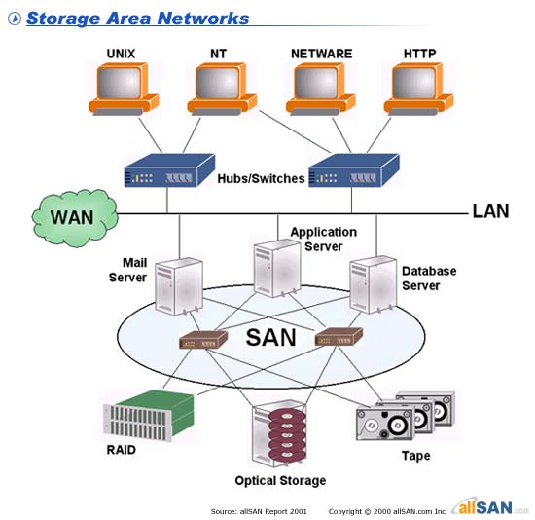
Kinds of Network
https://1.bp.blogspot.com/_bRyXIe5B1dk/TKUw9xEetdI/AAAAAAAAAIg/KVgi4pHlZWE/s1600/san1.jpg
Notes:
Local Area Network (LAN): small network,
limited to a single collection of machines and one
or more cables and other peripheral equipment
Internetwork: networked collection of LANs tied together by devices such as routers
– The Internet is the best example
Wide Area Network (WAN): internetwork that spans distances measured in miles and links two or more separate LANs
Metropolitan Area Network (MAN): uses WAN technologies to interconnect LANs in a specific geographic region, such as a county or a city

Slide 21
Kinds of Network
8. System-Area Network (also known as SysAN)
This term is fairly new within the past two decades. It is used to explain a relatively local network that is designed to provide high-speed connection in server-to-server applications (cluster environments), storage area networks (called “SANs” as well) and processor-to-processor applications. The computers connected on a SAN operate as a single system at very high speeds.
Notes:
Local Area Network (LAN): small network,
limited to a single collection of machines and one
or more cables and other peripheral equipment
Internetwork: networked collection of LANs tied together by devices such as routers
– The Internet is the best example
Wide Area Network (WAN): internetwork that spans distances measured in miles and links two or more separate LANs
Metropolitan Area Network (MAN): uses WAN technologies to interconnect LANs in a specific geographic region, such as a county or a city

Slide 22
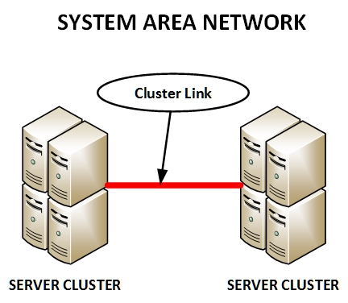
Kinds of Network
https://www.networkstraining.com/wp-content/uploads/2018/11/SYSTEM-AREA.jpg
Notes:
Local Area Network (LAN): small network,
limited to a single collection of machines and one
or more cables and other peripheral equipment
Internetwork: networked collection of LANs tied together by devices such as routers
– The Internet is the best example
Wide Area Network (WAN): internetwork that spans distances measured in miles and links two or more separate LANs
Metropolitan Area Network (MAN): uses WAN technologies to interconnect LANs in a specific geographic region, such as a county or a city

Slide 23
Kinds of Network
9. Passive Optical Local Area Network (POLAN)
POLAN technology can be integrated into structured cabling to overcome concerns about supporting traditional Ethernet protocols and network applications such as PoE (Power over Ethernet). A point-to-multipoint LAN architecture, POLAN uses optical splitters to split an optical signal from one strand of singlemode optical fiber into multiple signals to serve users and devices.
Notes:
Local Area Network (LAN): small network,
limited to a single collection of machines and one
or more cables and other peripheral equipment
Internetwork: networked collection of LANs tied together by devices such as routers
– The Internet is the best example
Wide Area Network (WAN): internetwork that spans distances measured in miles and links two or more separate LANs
Metropolitan Area Network (MAN): uses WAN technologies to interconnect LANs in a specific geographic region, such as a county or a city

Slide 24
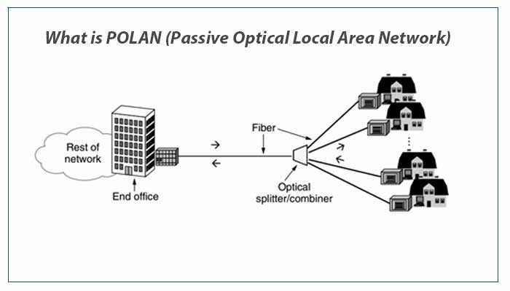
Kinds of Network
Notes:
Local Area Network (LAN): small network,
limited to a single collection of machines and one
or more cables and other peripheral equipment
Internetwork: networked collection of LANs tied together by devices such as routers
– The Internet is the best example
Wide Area Network (WAN): internetwork that spans distances measured in miles and links two or more separate LANs
Metropolitan Area Network (MAN): uses WAN technologies to interconnect LANs in a specific geographic region, such as a county or a city

Slide 25
Kinds of Network
10. Enterprise Private Network (EPN)
These types of networks are built and owned by businesses that want to securely connect its various locations to share computer resources.
Notes:
Local Area Network (LAN): small network,
limited to a single collection of machines and one
or more cables and other peripheral equipment
Internetwork: networked collection of LANs tied together by devices such as routers
– The Internet is the best example
Wide Area Network (WAN): internetwork that spans distances measured in miles and links two or more separate LANs
Metropolitan Area Network (MAN): uses WAN technologies to interconnect LANs in a specific geographic region, such as a county or a city

Slide 26
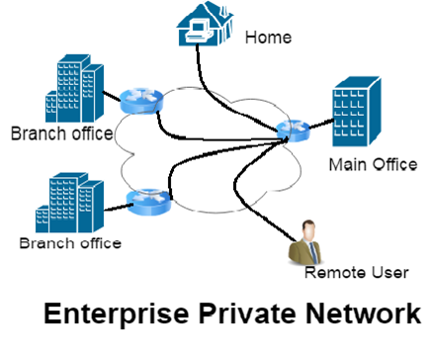
Kinds of Network
https://telcomaglobal.files.wordpress.com/2017/11/epn.png?w=809
Notes:
Local Area Network (LAN): small network,
limited to a single collection of machines and one
or more cables and other peripheral equipment
Internetwork: networked collection of LANs tied together by devices such as routers
– The Internet is the best example
Wide Area Network (WAN): internetwork that spans distances measured in miles and links two or more separate LANs
Metropolitan Area Network (MAN): uses WAN technologies to interconnect LANs in a specific geographic region, such as a county or a city

Slide 27
Kinds of Network
11. Virtual Private Network (VPN)
By extending a private network across the Internet, a VPN lets its users send and receive data as if their devices were connected to the private network – even if they’re not. Through a virtual point-to-point connection, users can access a private network remotely.
Notes:
Local Area Network (LAN): small network,
limited to a single collection of machines and one
or more cables and other peripheral equipment
Internetwork: networked collection of LANs tied together by devices such as routers
– The Internet is the best example
Wide Area Network (WAN): internetwork that spans distances measured in miles and links two or more separate LANs
Metropolitan Area Network (MAN): uses WAN technologies to interconnect LANs in a specific geographic region, such as a county or a city

Slide 28
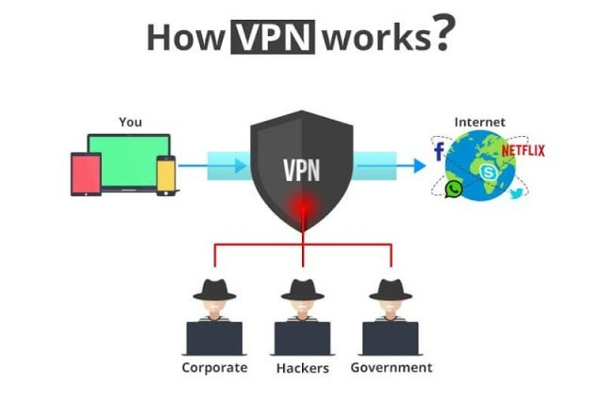
Kinds of Network
https://networkencyclopedia.com/wp-content/uploads/2019/09/vpn-diagram.png
Notes:
Local Area Network (LAN): small network,
limited to a single collection of machines and one
or more cables and other peripheral equipment
Internetwork: networked collection of LANs tied together by devices such as routers
– The Internet is the best example
Wide Area Network (WAN): internetwork that spans distances measured in miles and links two or more separate LANs
Metropolitan Area Network (MAN): uses WAN technologies to interconnect LANs in a specific geographic region, such as a county or a city

Slide 29
Developing a Networking Lexicon
Networking is a subject rich with specialized
terminology and technology.
Computer networks have spawned a language of their own, and half the challenge of becoming network literate lies in mastering this terminology.
Notes:
Networking is a subject rich with specialized
terminology and technology
Computer networks have spawned a language of their own, and half the challenge of becoming network literate lies in mastering this terminology
You must learn some new vocabulary

Slide 30
Network Medium
To communicate successfully, computers must share access to a common network medium
Computers must attach to the network medium by using some kind of physical interface.
For large-scale networks, multiple media usually work together (interoperate) across the total networking environment
Notes:
To communicate successfully, computers must
share access to a common network medium
Examples: twisted-pair, coaxial and fiber-optic cable,
and wireless media
Its job is to carry the signals one computer sends to one
or more other computers
Computers must attach to the network medium by using some kind of physical interface
Network interface card (NIC) or network adapter
For large-scale networks, multiple media usually work together (interoperate) across the total networking environment

Slide 31
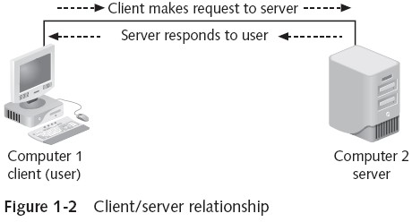
Clients, Peers, and Servers

Slide 32
Network Protocols
Network protocol:
common set of rules that allows two computers on a network to communicate with one another successfully
Notes:
Network protocol: common set of rules that
allows two computers on a network to
communicate with one another successfully
How to interpret signals, how to identify a computer on a network, how to initiate and end networked communications, and how to manage information exchange across the network medium
Examples:
TCP/IP
NetBEUI
IPX/SPX

Slide 33
Network Protocols
Network operating system (NOS): determines what services that computer can offer or request
Notes:
Network protocol: common set of rules that
allows two computers on a network to
communicate with one another successfully
How to interpret signals, how to identify a computer on a network, how to initiate and end networked communications, and how to manage information exchange across the network medium
Examples:
TCP/IP
NetBEUI
IPX/SPX

Slide 34
Network Services
server component - provides access to the resource
client component - requests access to the resource
Both components - service
Notes:
Sharing resources and communication requires two components: a server component that provides access to the resource and a client component that requests access to the resource
Both components are referred to as a service
NOSs must be outfitted with the types of services your client operating systems require, whether they are Web servers, e-mail servers, file and print servers, and so on

Slide 35
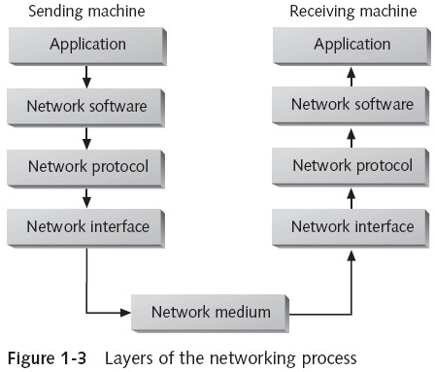
Layers of the Networking Process

Slide 36
Understanding Network Types
two major network types:
peer-to- peer
client/server
Server-based networks - the most typical
Notes:
Networks fall into two major types: peer-to- peer and client/server (also called server-
based)
This discussion of network types addresses the roles that computers play on the network and how those roles interact
Server-based networks are the most typical and represent the primary focus of the discussion here
Understanding both types is essential, especially as they compare with one another

Slide 37
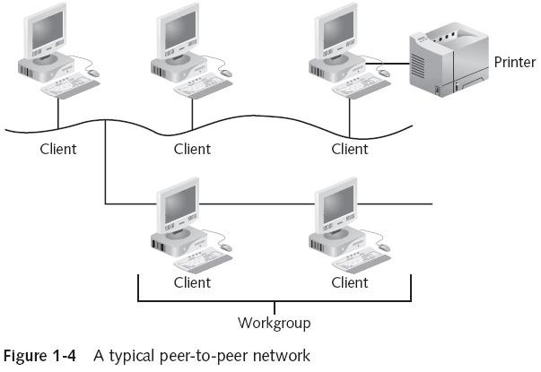
Peer-to-Peer Networking

Slide 38
Peer-to-Peer Networking
every user must also act as a network administrator
network administrator - controls access to the resources on their machines
Notes:
In a peer-to-peer network, every user must also act as a network administrator,
controlling access to the resources on their
machines
Because of this flexibility and individual discretion, institutionalized chaos is the norm for peer-to-peer networks, and security can be a major concern
Computers can be affiliated into loose federations called workgroups, but no network-wide security can be enforced
As the number of users and resources grows, these
networks can become unworkable

Slide 39
Peer-to-Peer Networking Advantages
Advantages:
Easy to install and configure
Machines don’t depend on the presence of a dedicated server
Users control their own shared resources
Inexpensive to purchase and operate
Need no additional equipment or software beyond a suitable operating system
No dedicated administrators are needed
Work best for networks with 10 or fewer users

Slide 40
Peer-to-Peer Disadvantages
Disadvantages:
– Network security applies to only a single resource at a
time
Users might be forced to use as many passwords as there are shared resources
Each PC must be backed up to protect shared data
When a shared resource is accessed, performance of
the PC where the resource resides is reduced
There is no centralized organizational scheme to locate
or control access to data
Access to a shared resource is unavailable if PC where resource resides is turned off/crashes
Doesn’t usually work well with more than 10 users

Slide 41
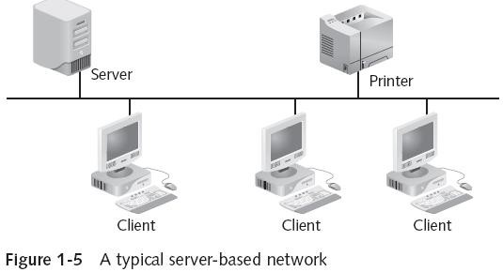
Server-Based Networks

Slide 42
Server-Based Advantages
Centralized user accounts, security, and access controls simplify network administration
More powerful equipment means more efficient
access to network resources
Server hardware design is generally more robust
A single password delivers access to network- wide resources as specified in access controls
Server-based networking makes the most sense for networks with 10 or more users or any networks where resources are heavily used

Slide 43
Server-Based Disadvantages
At the worst, server failure renders a network unusable; at the least, it results in loss of network resources
Complex server software requires allocating
expert staff, which increases expenses
Dedicated hardware and specialized software add to the cost of server-based networking

Slide 44
Week 5 Lesson
Role of Network Servers
Types of Network Servers
Selecting the Right Type of Network

Slide 45
Role of Network Servers
The server is at the heart of any network that’s too large for a peer-to-peer configuration
Most large networks with more than a few dozen workstations rely on several network servers
Your knowledge of a server’s unique hardware requirements and the many roles it can play in a network is essential to being able to design and support today’s computer networks

Slide 46
Specialized Servers
Within the broad classification of machines that function as network servers, assigning a variety of specialty roles is possible, depending on the services provided
On large networks in particular, servers with specialized roles are often deployed.

Slide 47
Web Servers
Web Server is software and hardware that uses HTTP (Hypertext Transfer Protocol) and other protocols to respond to client requests made over the World Wide Web. The main job of a web server is to display website content through storing, processing and delivering webpages to users.

Slide 48
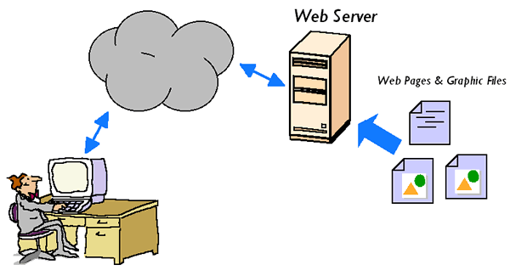

Slide 49
Application Servers
Application servers supply the server side of client/server applications, and often the data that goes along with them, to network clients
It is for controlling forms, codes and data.
Designed to run together with a Web Server.

Slide 50
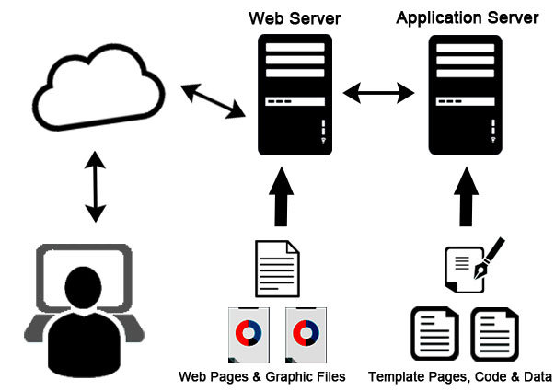
Application Servers
https://globalresearchreportnews.files.wordpress.com/2020/07/application-server.jpg

Slide 51
Communication Servers
Communication servers provide a mechanism for users outside a network to access that network’s resources, and sometimes permit users on a network to access resources outside network’s local scope
Often, installing communication servers on a network enables users who are traveling or working at home to dial in to the network via a modem

Slide 52
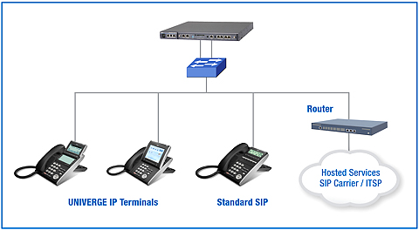

Slide 53
Domain Controllers/Directory Servers
Make it possible to locate, store, and secure information about a network and its resources
Windows Server permits computers, users, groups, and resources to be combined into logical groups called domains
A user belonging to a domain can access all resources and information that he or she has permission to use simply by logging on to the domain
Server that handles this logon service is a domain controller or directory server

Slide 54
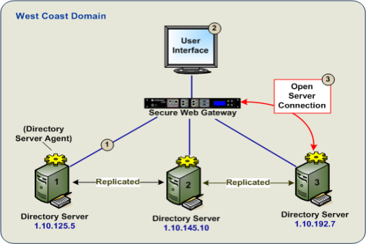

Slide 55
Fax Servers
Fax servers manage fax traffic for a network
Receive incoming faxes via telephone, distribute them to recipients over the network, and collect outgoing faxes across the network before sending them via telephone
Use one or more fax modem interfaces to perform these tasks
As with most communication servers, Windows-
, NetWare-, and Linux-based fax servers come from third parties instead of the platform vendors

Slide 56
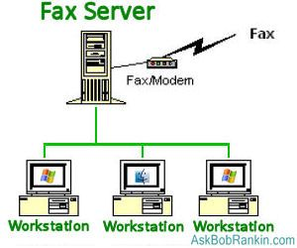

Slide 57
File and Print Servers
File and print servers provide basic network file storage, retrieval services, and access to networked printers
Users can run applications locally but keep data files on the server (and print those files when they want hard copies)
Any Windows, NetWare, or Linux server can act as a file and print server

Slide 58
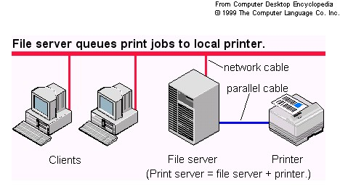

Slide 59
Mail Servers
Mail servers handle e-mail messages for users
Might involve simply acting as a clearinghouse for local exchange of messages
Also commonly provide “store-and-forward” services
Can store outgoing messages until a connection to an external mail server is established, and then forward messages to their intended destinations

Slide 60
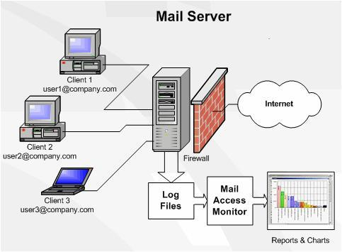

Slide 61
Web-Based Networks
Most computers today are connected to the Internet, and the latest handheld devices are connecting through wireless communications
Because of the always-on connections available via DSL and cable modems, the Web is an integral and seamless part of the computing experience

Slide 62
.Net Computing
The Microsoft .NET computing model uses the Web to deliver applications and to enable applications on different devices running different operating environments to communicate and share data.

Slide 63
Web-Enabled Devices
WPANs allow devices within a person’s personal
space to communicate
Many devices used in a WPAN are Web-enabled devices that can gather and send information via the Internet
Other devices are becoming Web-enabled
– For example, automobiles
A host of devices are being created that can access the Web, thus shifting the networking paradigm from clients and servers to Web-enabled and not Web-enabled

Slide 64
Selecting the Right Type of Network
You have a number of choices to make when deciding how to design and implement a network
Will a single LAN do, or is an internetwork required?
Is a MAN or WAN required?
Will peer-to-peer networking suffice, or is a server- based network in order?
Do some functions need to be server-based while others work well as a peer-to-peer network?

Slide 65
Choosing a LAN Versus an Internetwork
The following sections offer a brief summary to help in the decision-making process:
The decision to design a LAN or an internetwork is
primarily based on how many total computers will participate on the network and whether there’s a need to tie groups of computers together with network devices such as routers
The distance the network will span also plays a part in
the decision
A LAN is usually called for when:
The number of computers is fewer than 24
Network use and security factors don’t require a router
The network is confined to a single building or floor

Slide 66
Is it a MAN or a WAN?
If you need the services of a communications provider to tie multiple sites together, you have a MAN or WAN
The only real difference is whether the sites are confined to a town or city or whether the sites are located in different cities
Within one town or city, the network is generally
referred to as a MAN
If the network spans different cities, it’s considered as a WAN

Slide 67
Peer-to-Peer or Server-Based Network
Choosing peer-to-peer networking exclusively is appropriate only when all the following hold:
The network includes no more than 10 users
All networked machines are close enough to fit
within the span of a single LAN
Budget considerations are paramount
No specialized servers are needed

Slide 68
Peer-to-Peer or Server-Based Network
A server-based network makes sense when one or more of the following conditions is true:
More than 10 users must share network access
Centralized control, security, resource management, or backup is desirable
Users need access to specialized servers, or they place heavy demands on network resources
An internetwork is in use
Hybrid network uses elements of both a server-based network and a peer-to-peer network

Slide 69
References
https://www.belden.com/blog/smart-building/network-types
https://www.javatpoint.com/types-of-computehttps://networkencyclopedia.com/virtual-private-network-vpn/r-network
https://www.guru99.com/types-of-computer-network.html
https://study.com/academy/lesson/types-of-networks-lan-wan-wlan-man-san-pan-epn-vpn.html

Slide 70
Activity
Select three (3) Network Types from the lesson and then create an illustration for each type that you selected. Label you work accordingly.
Explain what Server Connection is applicable to your 3 selected networks.

